Slide 1
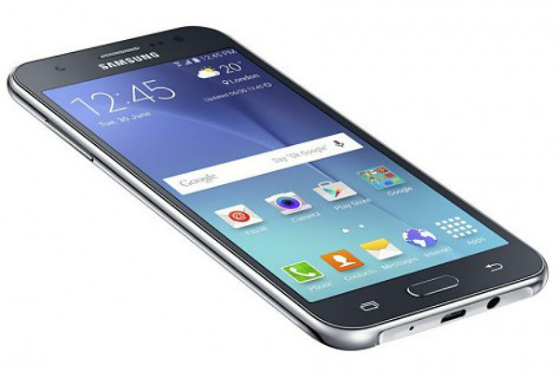
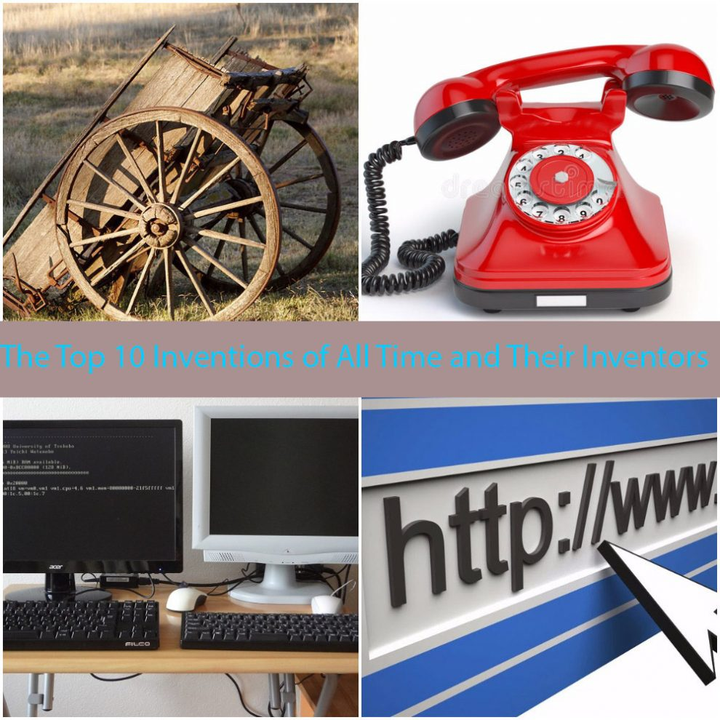
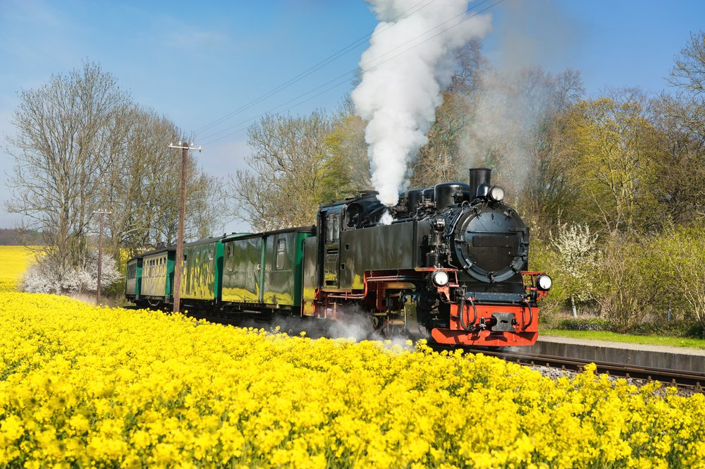
Unit 10

Slide 2

البوابة الكويتية لصعوبات التعلم (redsoft.org)

Slide 3


Slide 4
Pinterest

Slide 5
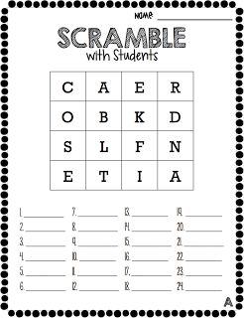

Slide 6


Slide 7
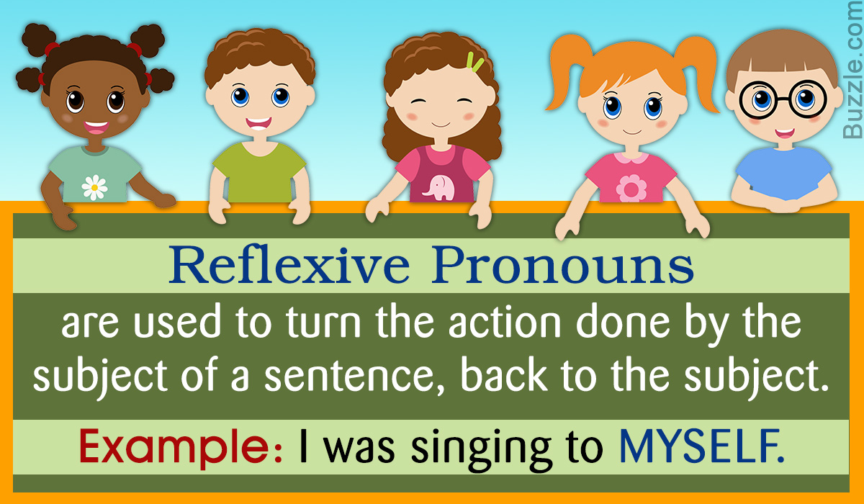

Slide 8

many – a few
many
1. There are ……………………….. students in the library.
a few
2. I bought some milk and …………….……………. apples.
many
3. The basket is full of ………………………. cupcakes.

Slide 9
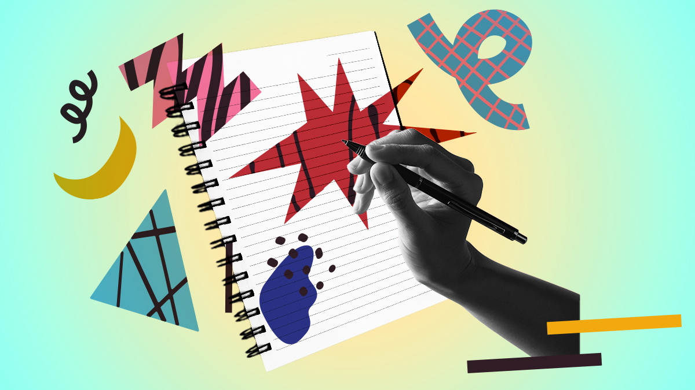

Slide 10
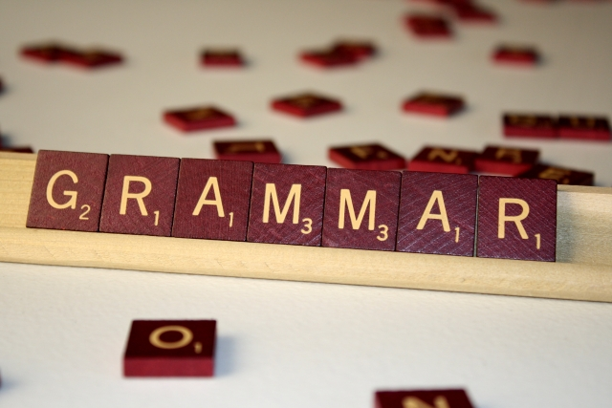
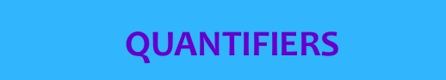
a few
many
much
a little

Slide 11
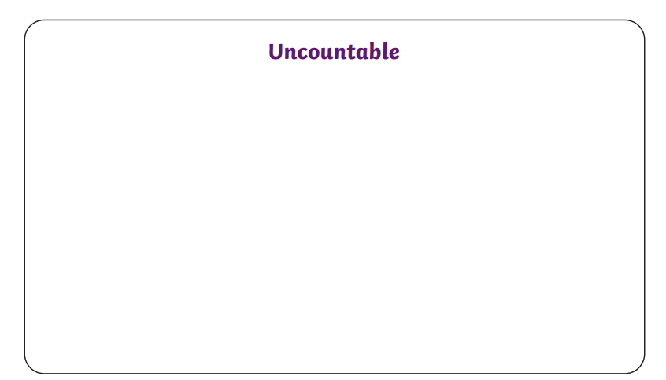

Slide 12
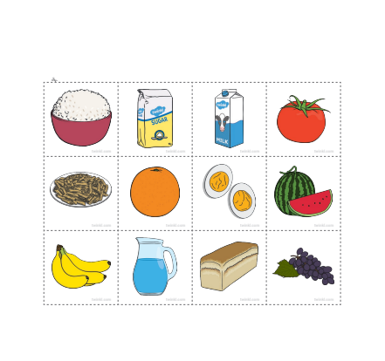

Slide 13
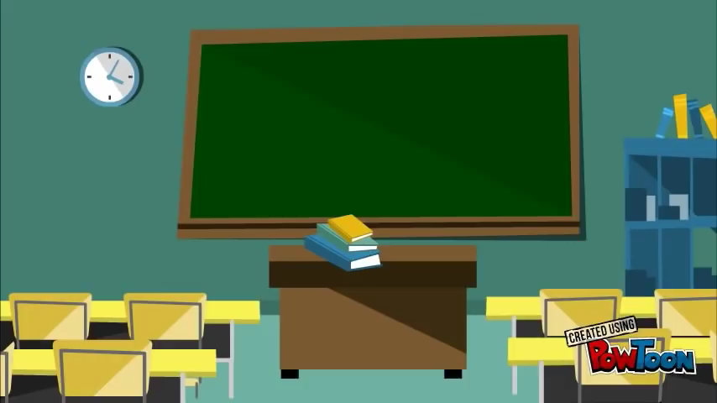

Slide 14
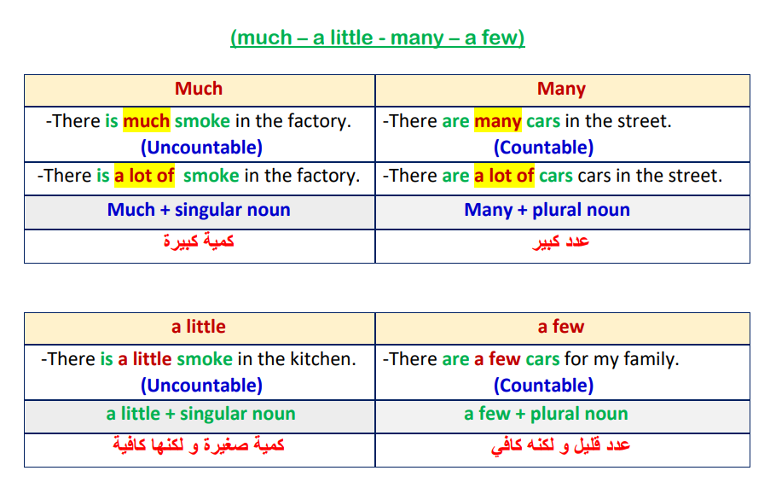

Slide 15
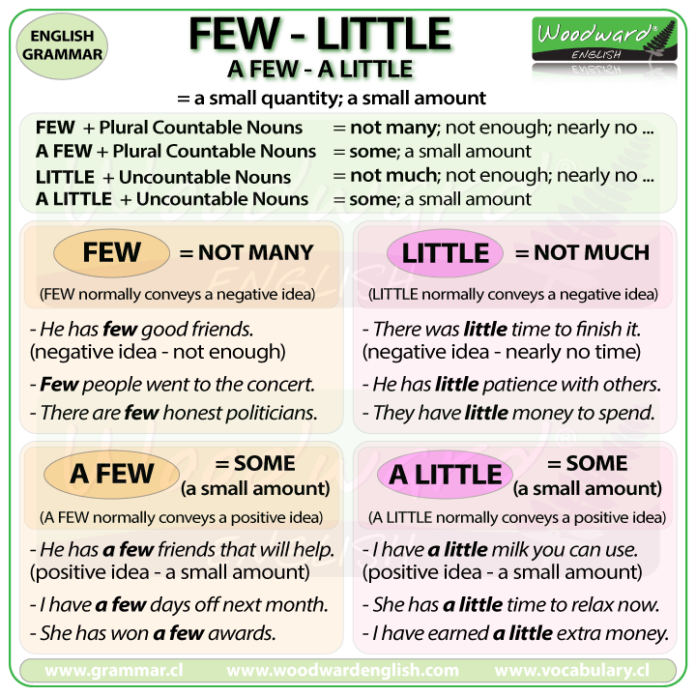
countable
uncountable

Slide 16
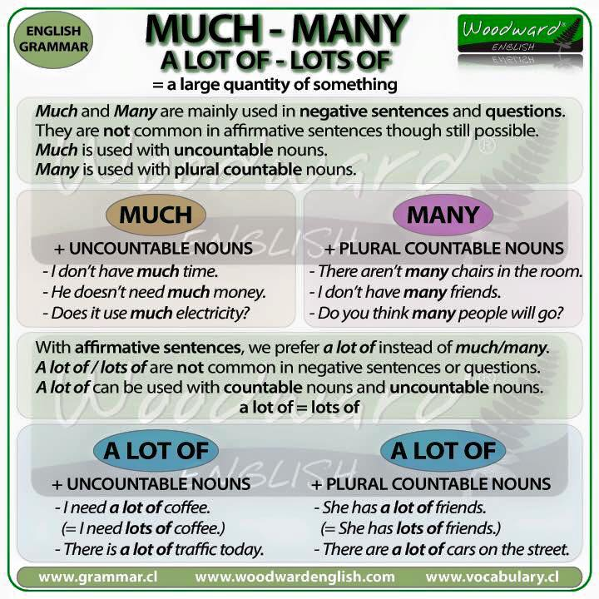

Slide 18

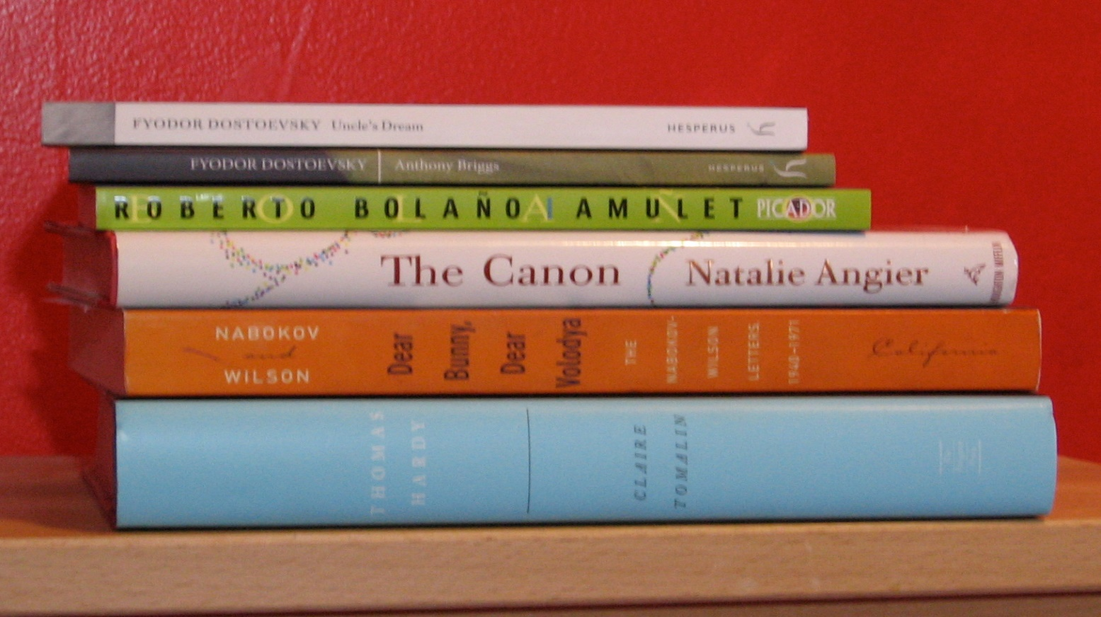
many/ a few + a countable noun
There are a few books about the history
of inventions in our school library.
a few

Slide 20
Grammar Check

Slide 21
Choose the correct answer from a, b, c, & d:
1. There are...................... car parks in the center of city, we need to have more.
a) much b) a little c) many d) a few
2. I need ............................sugar in my tea.
a) much b) a little c) many d) a few

Slide 22
Choose the correct answer from a, b, c, & d:
3. Hurry up! We only have ....................... time before the coach leaves.
a) much b) a little c) many d) a few
4. There are ...................... shops near the university.
a) much b) a little c) many d) a few

Slide 23
Choose the correct answer from a, b, c, & d:
5. It's very quiet. There aren't …………………… people here today.
a) much b) a little c) many d) a few
6. He isn't very popular. He has ....................... friends
a) much b) a little c) many d) a few

Slide 24
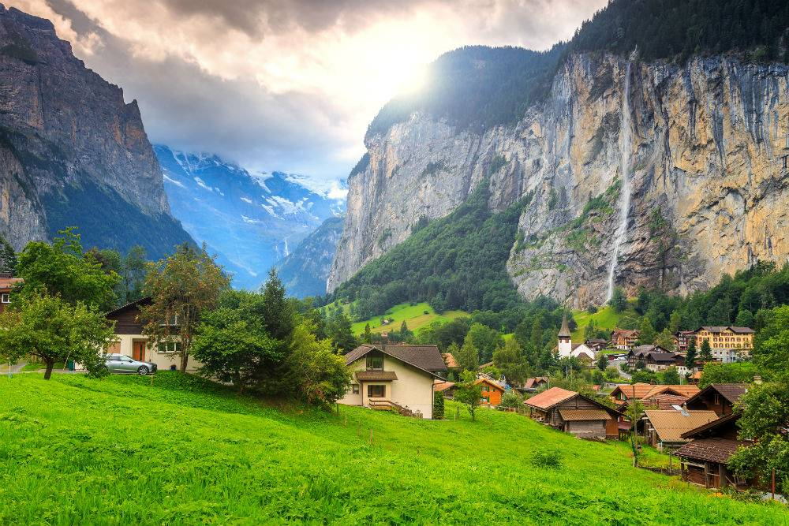

Watch the video, and then do the exercise below.

Slide 25

a few = countable a little = uncountable

Slide 26
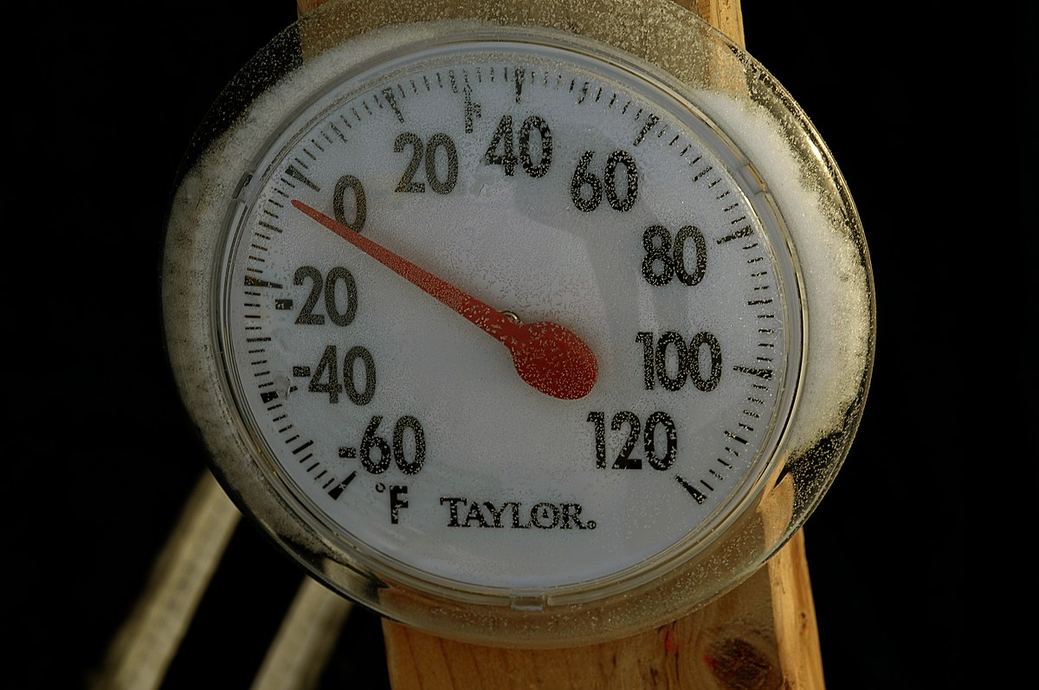
Check your answers!

Slide 27
a. Fill in the table with words from the list:
kilos – butter – shoes – money – months – photos – sand – milk – rice – dinars
a few
kilos
shoes
months
photos
dinars
a little
rice
butter
money
sand
milk

Slide 28
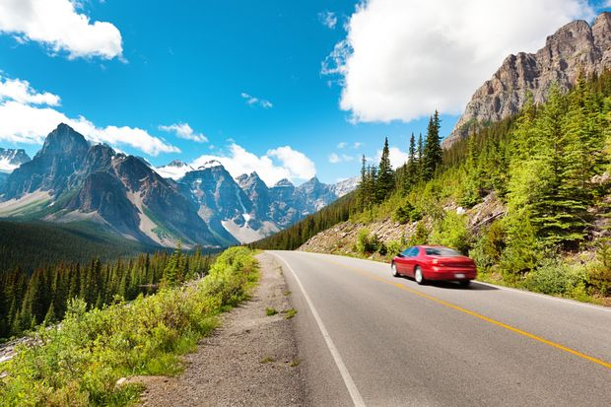
Student’s Book
Page 80

Slide 29



Slide 30
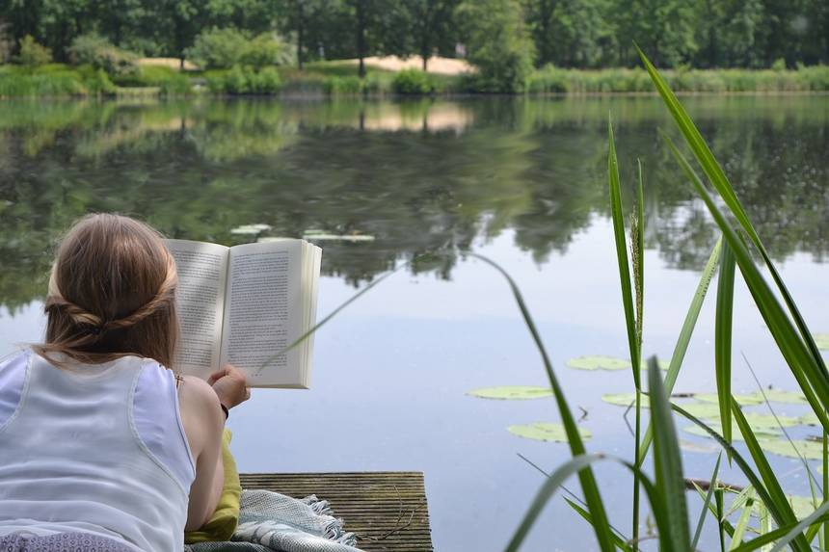
Check your answers.

Slide 31
b. Complete the following sentences with
a few / a little / much / many:
1. I haven’t got …………….........… time, we’ll have to talk fast.
2. There will be …………….........………… rain this week.
3. I have …………….........… close friends. It’s hard to find a true friend.
4. There aren’t …………….....………… extra chairs in our classroom, we need more.
much
a little
a few
many

Slide 32
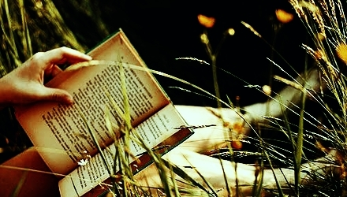
Closure

Slide 33
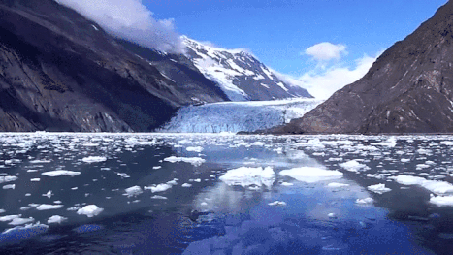
Watch the video, and then choose the correct quantifiers:

Slide 34


Slide 35
much – a little
much
1. I spend ………………………. time reading novels.
much
2. There wasn’t ……….……………. traffic this morning.

Slide 36
much – many – a little – a few
a little
3. There is ……………………….. butter in the fridge.
a little
4. I didn’t eat much. Just …………….……………..
much
5. How …………….……………. Money do you have?

Slide 37
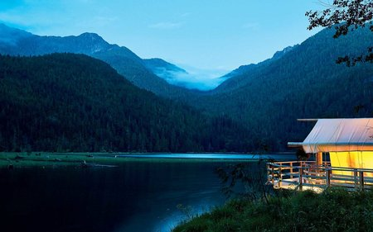
Thank you

